Slide 1
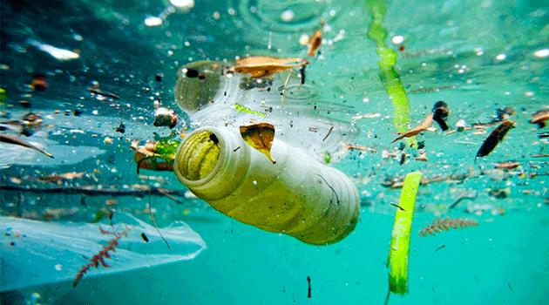
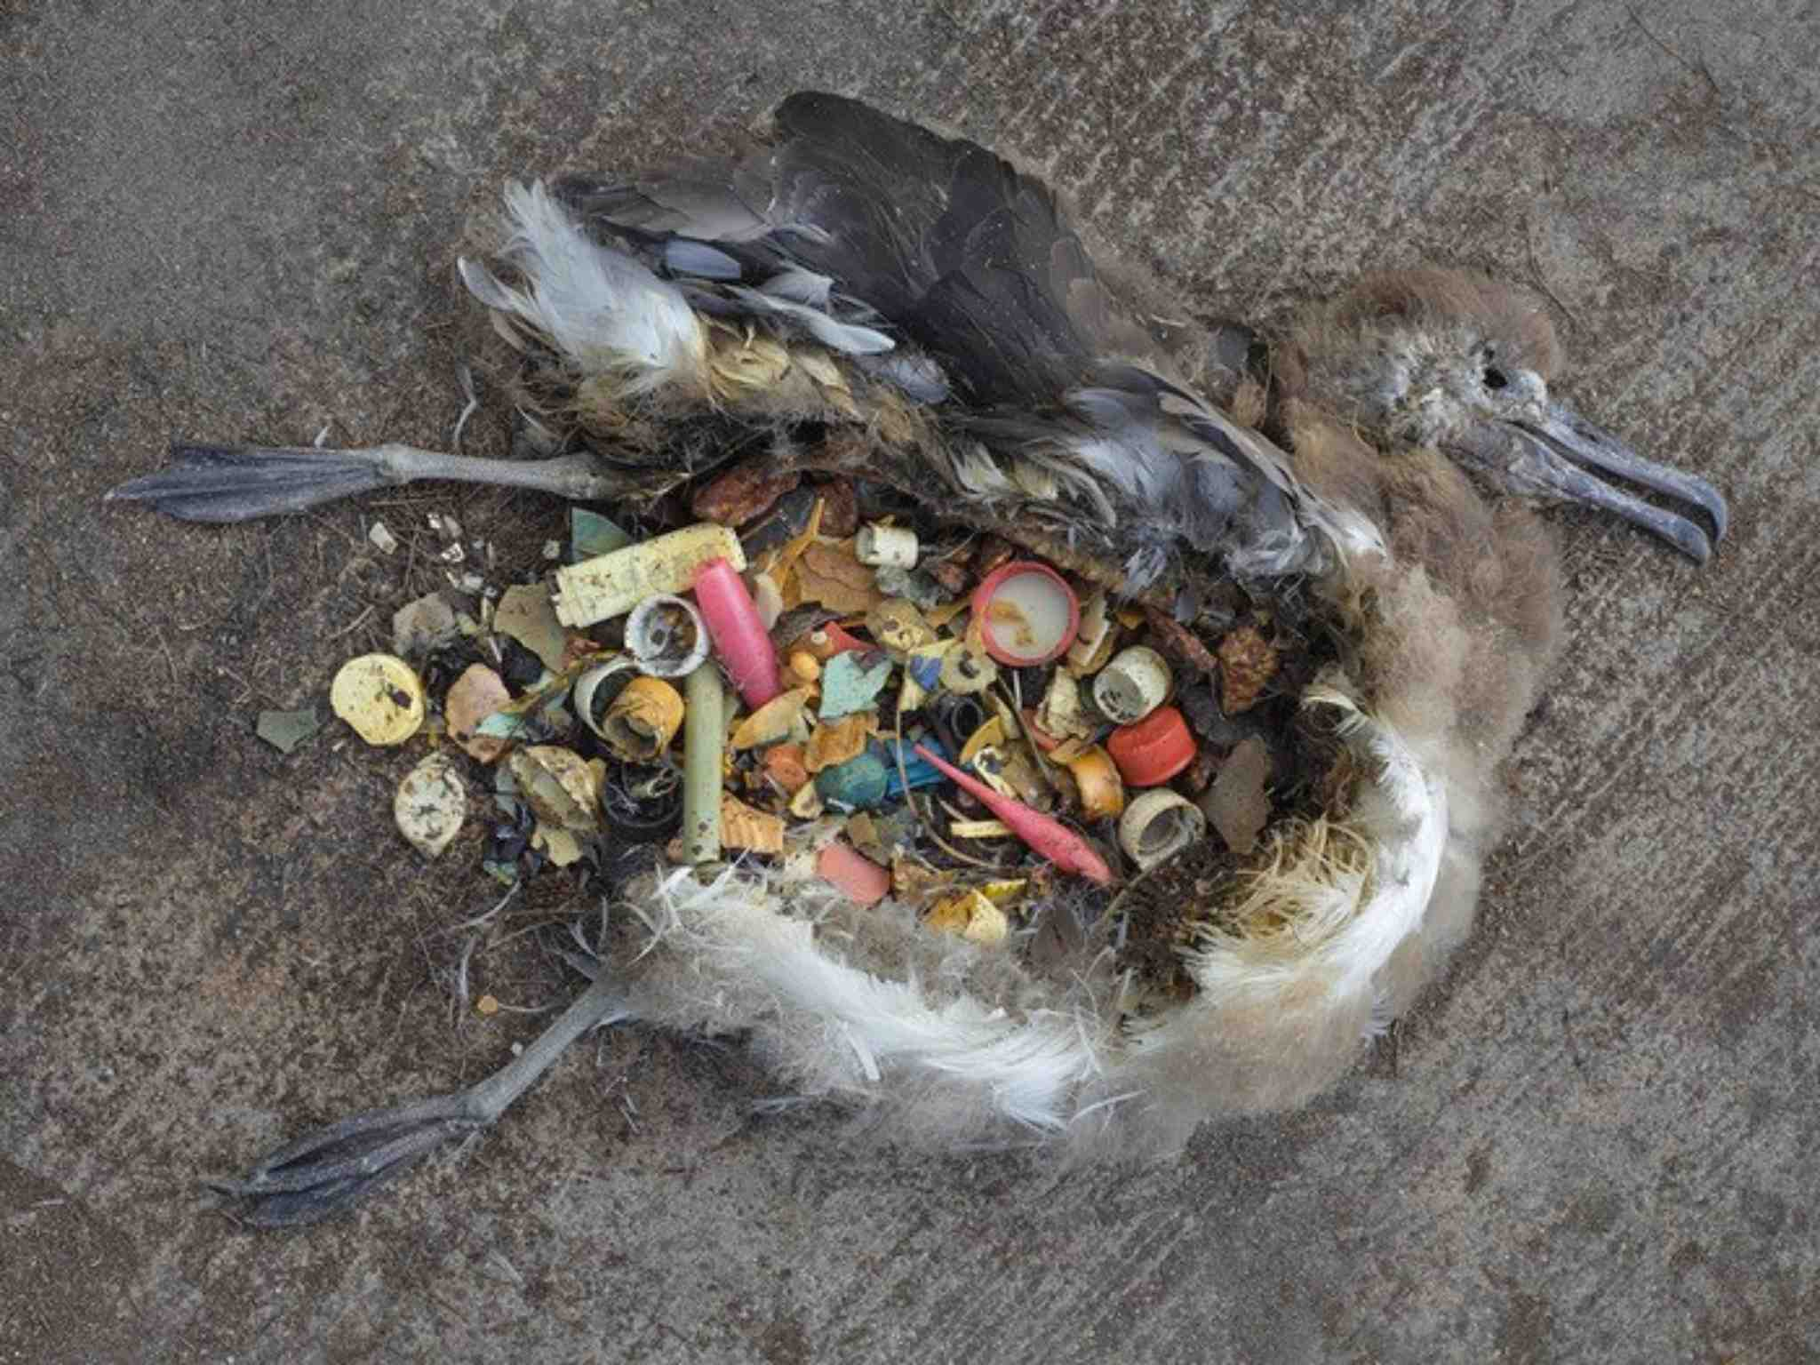
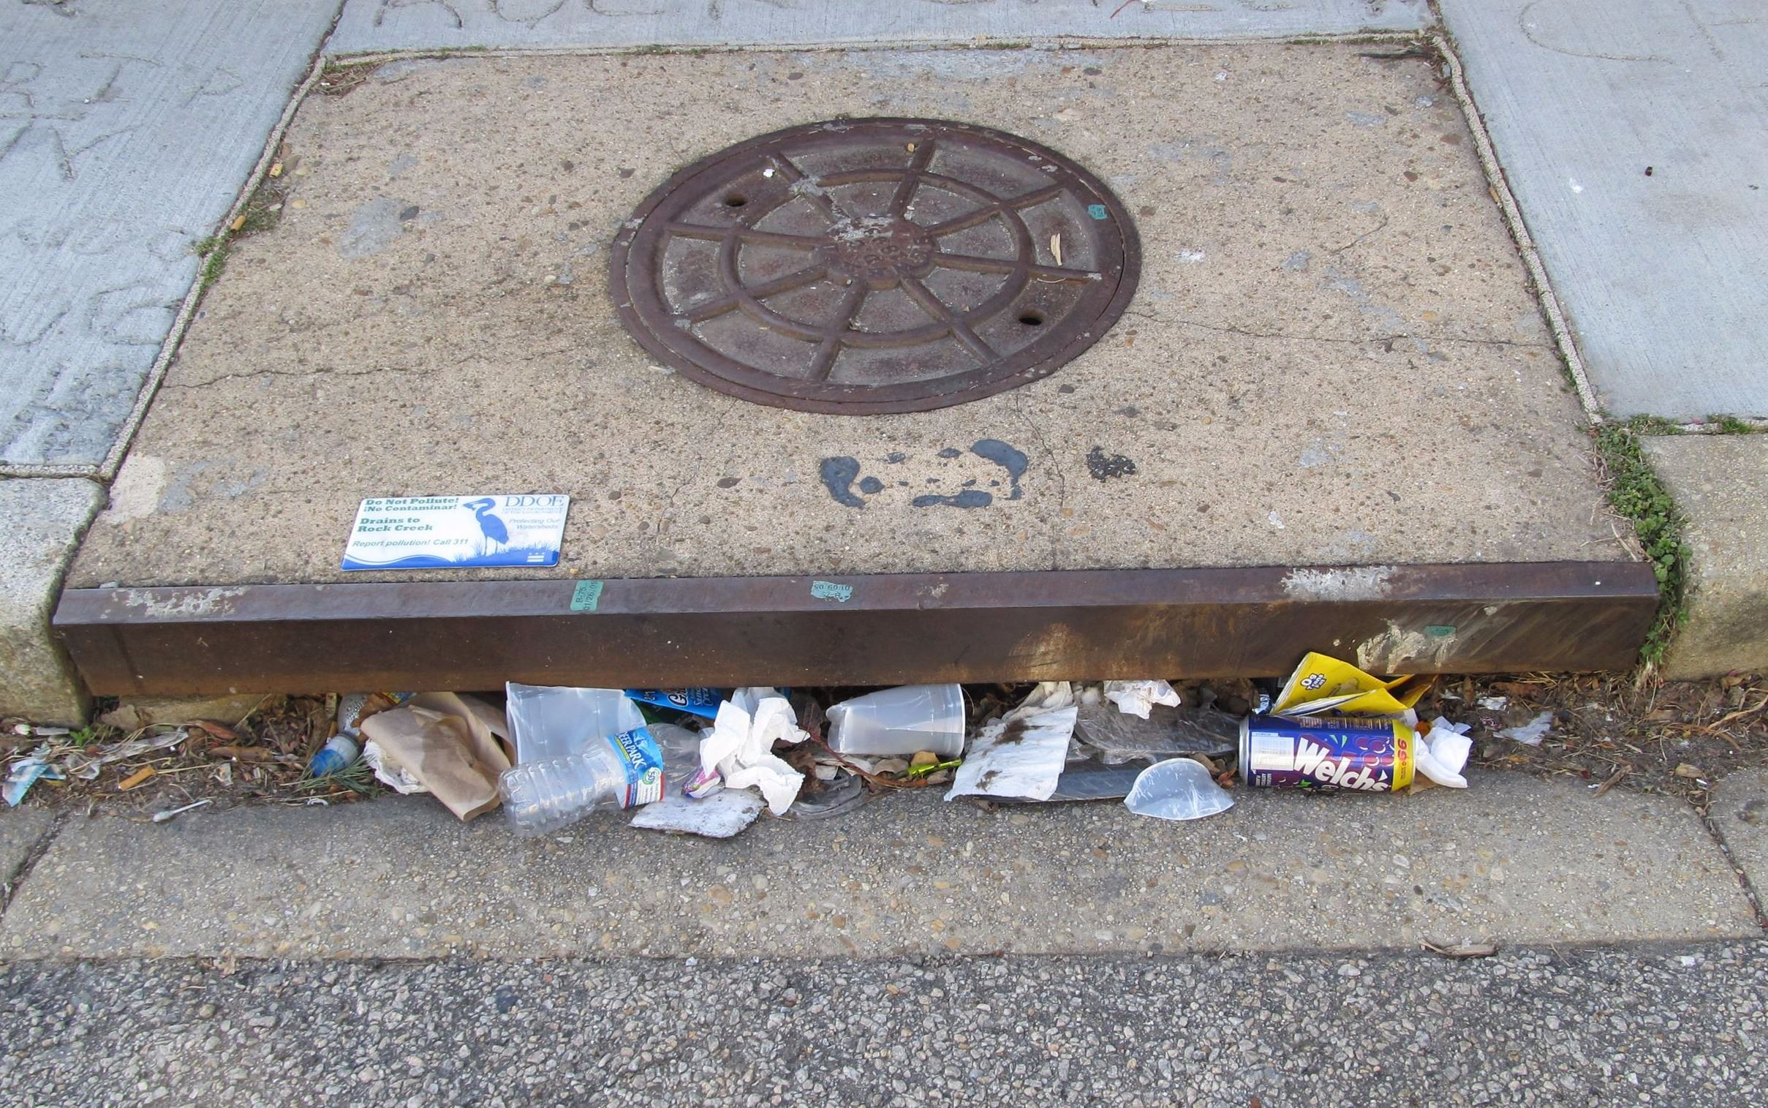

THE PROBLEM
Water Pollution
Wildlife Harm
Clogged Drainage
Notes:
Percent of people who have admitted to littering in the past 5 years 75%. Total amount of litter that is dumped into the ocean every year 9 billion tons.

Slide 2
THE SOLUTION

Slide 3
Finders
Sweepers

Slide 4
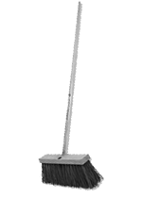

Every Day, Choose Either:
Finder
Sweeper
OR

Slide 5
FINDERS

Slide 6
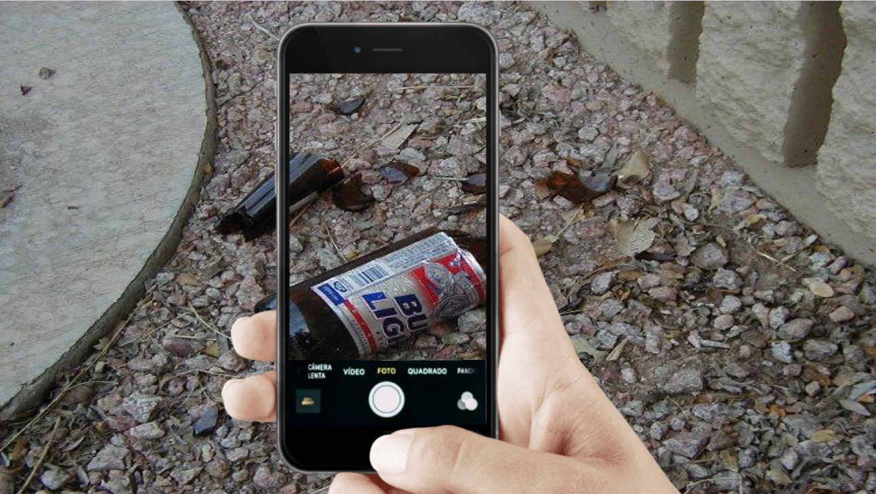
Take Pics of Discovered Litter

Slide 7

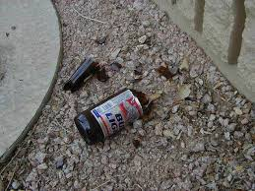

Select Description
Glass Bottle
Plastic Bottle
Cigarette
Plastic Bag
Litter Added to Map!
Other
+ 5 Points
Continue
Find More
Describe the Litter
Post Litter to Map

Slide 8
SWEEPERS

Slide 9
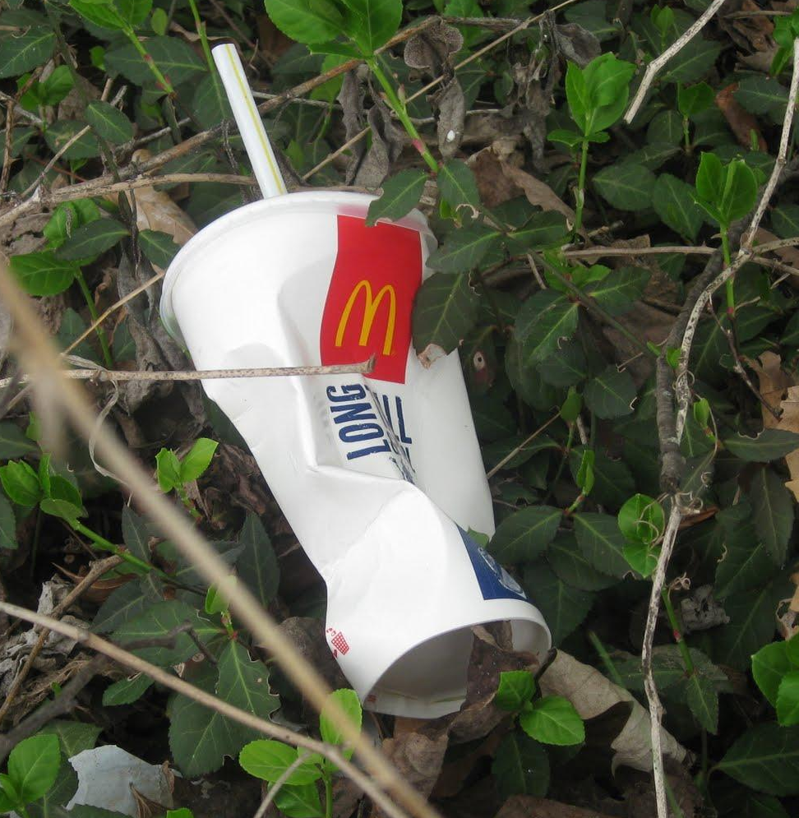
Litter Found Near You!
Swept!
Tap Desired Litter On Map
Get Walking Directions and Pick It Up

Slide 10
Add Litter to Your Litter Wall
Litter Swept!
+ 5 Points
+ 1 Litter to Litter Wall
Sweep More

Slide 11
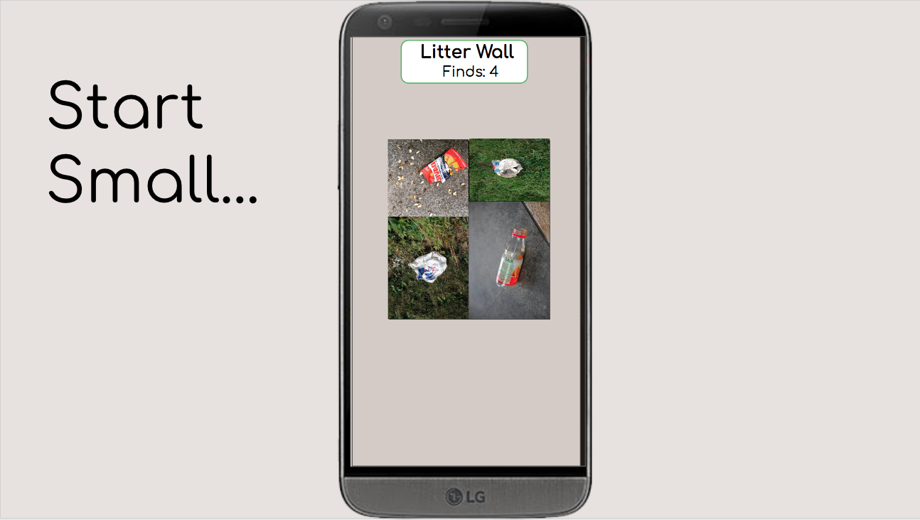

Slide 12
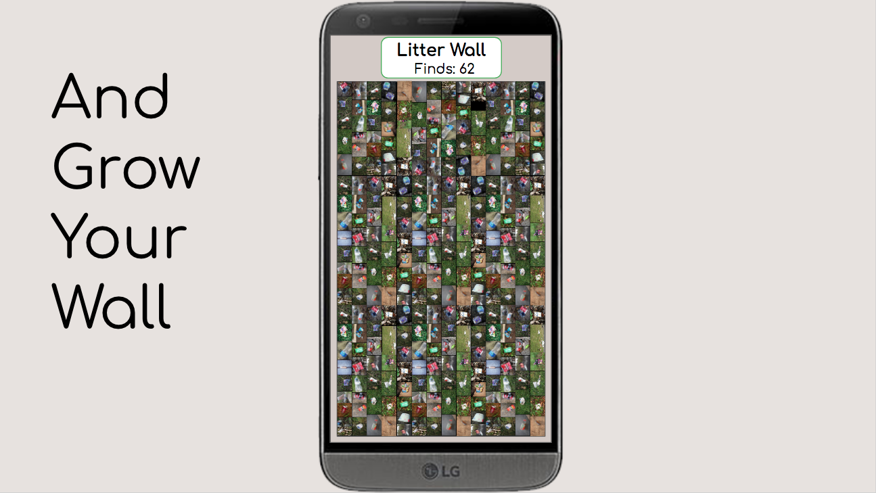

Slide 13



Challenges
?
Front-End
Back-End

Slide 14
FUTURE ADDITIONS
Personal Profiles
Implement Game Currency
Levels
Camera / Photo Wall

Slide 15
Finders
Sweepers

